Slide 1
Sarah Nahas

Slide 2
Netflix - “We Want to Entertain the World”
Recently we were provided a chance to support Netflix in undertaking a very thorough examination of the present environment for streaming. It is a major international streaming service that offers customers hundreds and thousands of TV shows, films, documentaries and various other original titles from around the world. In all those years, Netflix has transformed itself into a digital platform through which users can stream contents that can be displayed on multiple smart devices.Having a vast amount of products such as original movies and TV series, Netflix is now one of the key players of the entertainment market with consumers being able to watch their stuff anywhere without any limitations. Thus, for these purposes we have come up with an objective to discover chances that can be used in raising the present media strategies of Netflix. The analysis in itself will formulate some insights and recommendations, which will be part of a road map that would help Netflix and ourselves meet the current objective. Apex Analytics will be able to skillfully gather relevant information, then strategically set it up to meet our overall objectives and goals. In summary, this presentation will be a plan and guide to support the construction of a detailed report which will be better than what Netflix would want and expect.

Slide 3
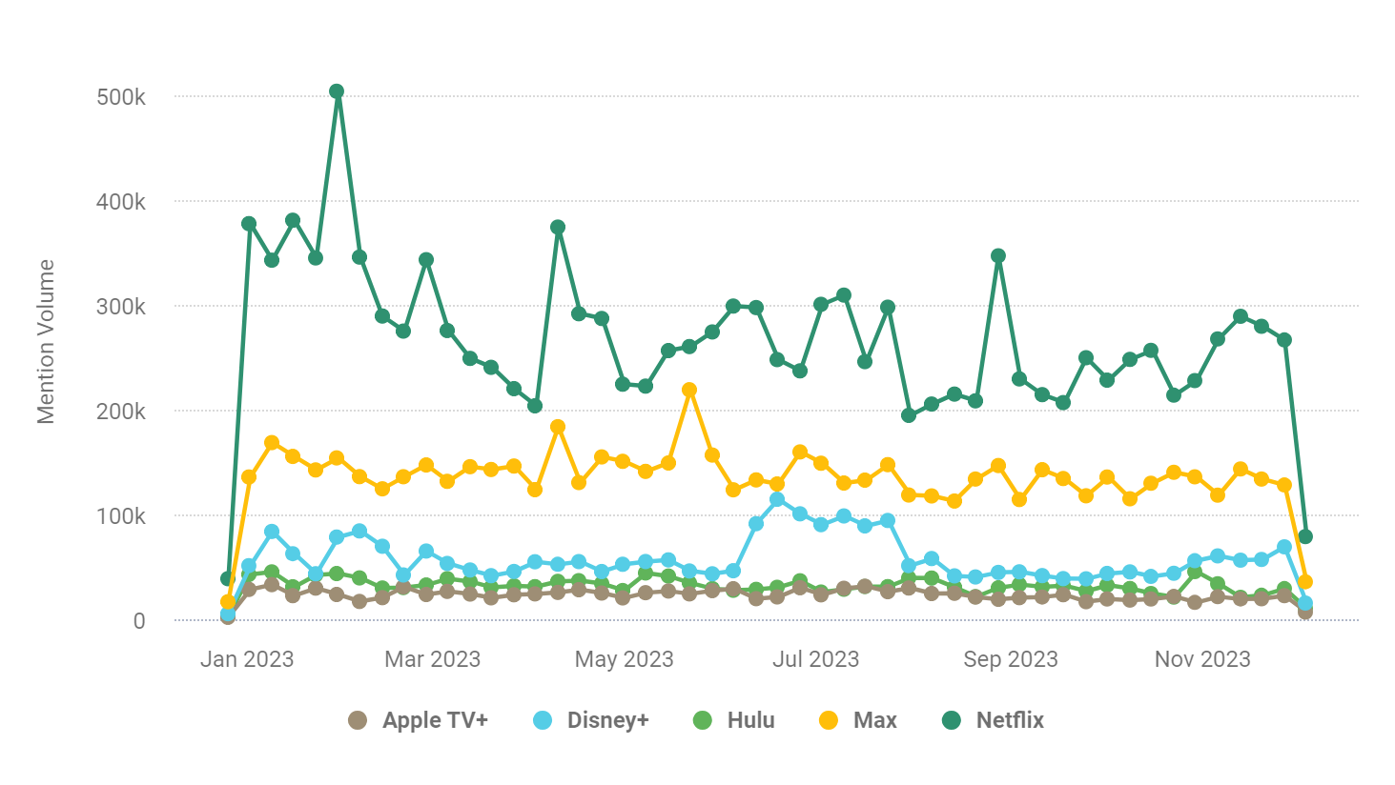
Intro
They are currently placed in a competitive landscape with Netflix in Leadership Position
Goals:
Drive new and existing subscriber engagement
Better Promote content relative to competitors
Defend against reputation threats
Based off of this graph, we can clearly see how much of a leader Netflix is within the streaming industry.

Slide 4
Driving New and Existing Subscriber Engagement
Netflix will have to take maintain a competitive edge, if they are to remain ahead of its competitors in the current competitive streaming industry. It is crucial for the company to adopt effective promotional strategies that will not only attract new subscribers but also retain existing ones amidst a a vass array of alternatives. Moreover, enhanced content promotion helps subscribers understand what a broad selection of quality shows they can access on the current ad platform. By implementing this, it would result in improved viewer satisfaction, higher loyalty rates, and growth potential in heightened viewer satisfaction, increased loyalty rates, and sustained growth within this fast-paced and cutthroat streaming market landscape.. Effective content promotion enables a subscriber to understand the breadth and quality of the offerings while raising the bar among many competitors. Furthermore, it increases subscribers’ loyalty and creates viewer satisfaction, which further results in sustainable company growth in the highly dynamic and competitive streaming industry.

Slide 5
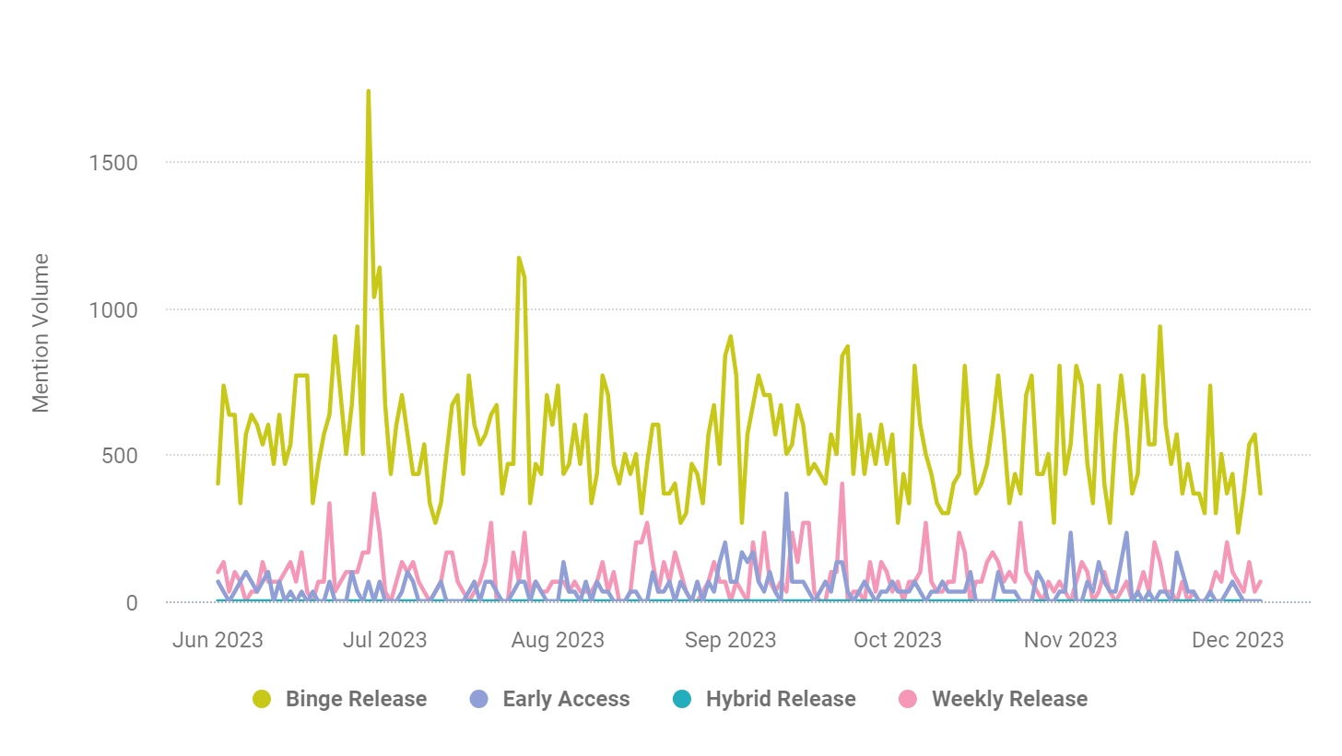
Hypothesis 1: Release Strategy Impacts more Engagement
Based off of the chart(s) at hand we can see that when content is being put out as a “binge release” it drives more mention volume over time, while weekly releases run in second place. By continuing on by using a ‘Binge Release’ strategy will be the best constant part of Netflix’s strategy to remain.

Slide 6
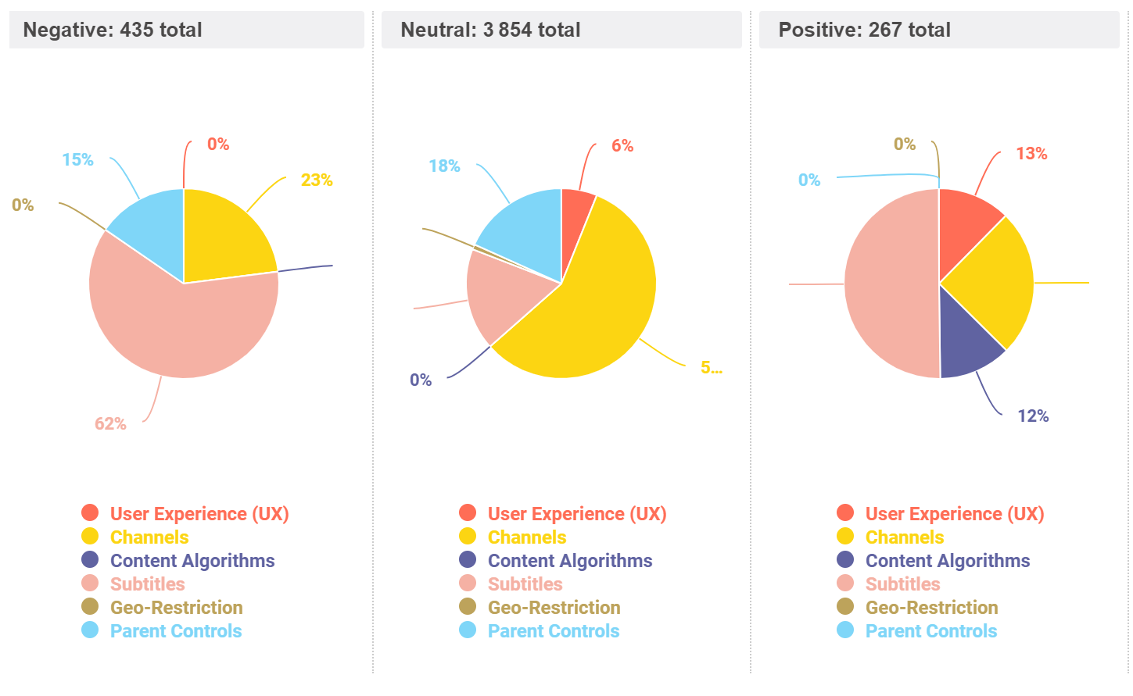
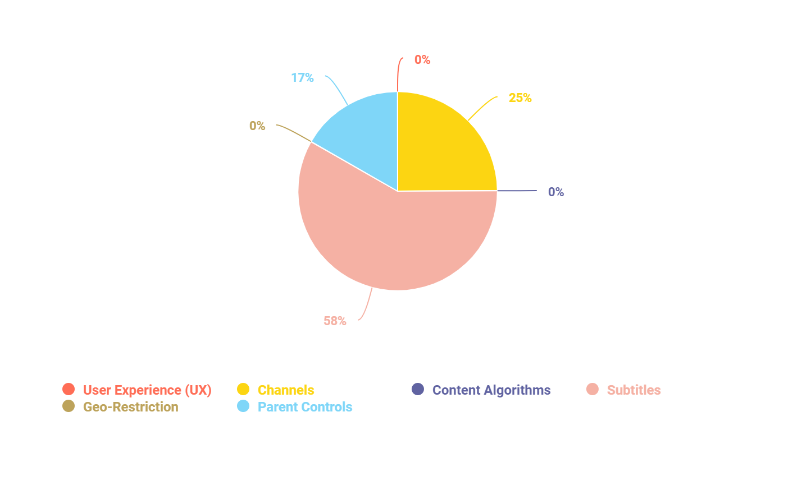
Hypothesis 2: Platform Features will Impact Subscriber Engagement
The first figure showcases the sentiment behind Netflix’s current features with subtitles and channels in the lead for both positive and negative sentiments. The second figure give as an overview of the mention volume in regards to the features at hand, and we can still see how subtitles are overwhelmingly there. Therefore we need to properly investigate, using a case study, as to why our target audience views subtitles (negatively/positively) and how we can improve upon this feature based off of our user’s personal experience.

Slide 7
Better promote its content relative to competitors
Netflix needs to enhance its content promotion to stay competitive in the neck to neck streaming industry. Effective promotion is essential for attracting and retaining customers in the face of numerous possible alternatives (competitors). By strategically marketing and analyzing current trends and strategies,, Netflix will be able differentiate themself, capture audience attention effectively, and drive viewer engagement. Improved content promotion not only helps in standing out amidst competitors but also ensures that consumers are aware of the breadth and quality of offerings that Netflix has to offer, leading to increased viewer satisfaction, loyalty, and sustained growth in the highly dynamic and competitive streaming market.

Slide 8
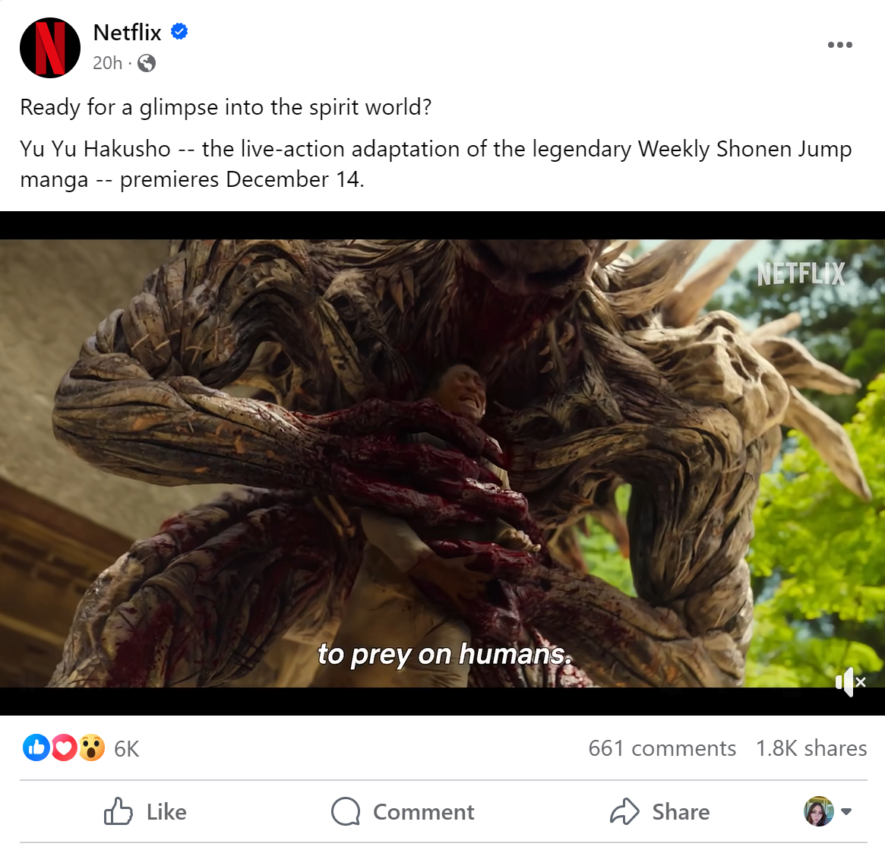
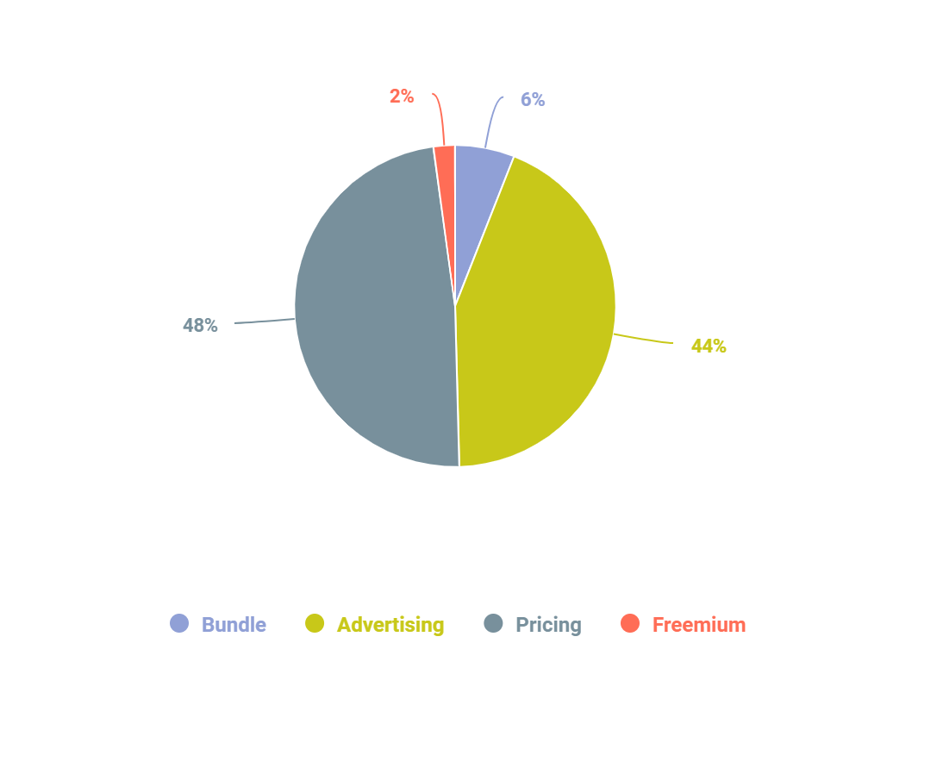
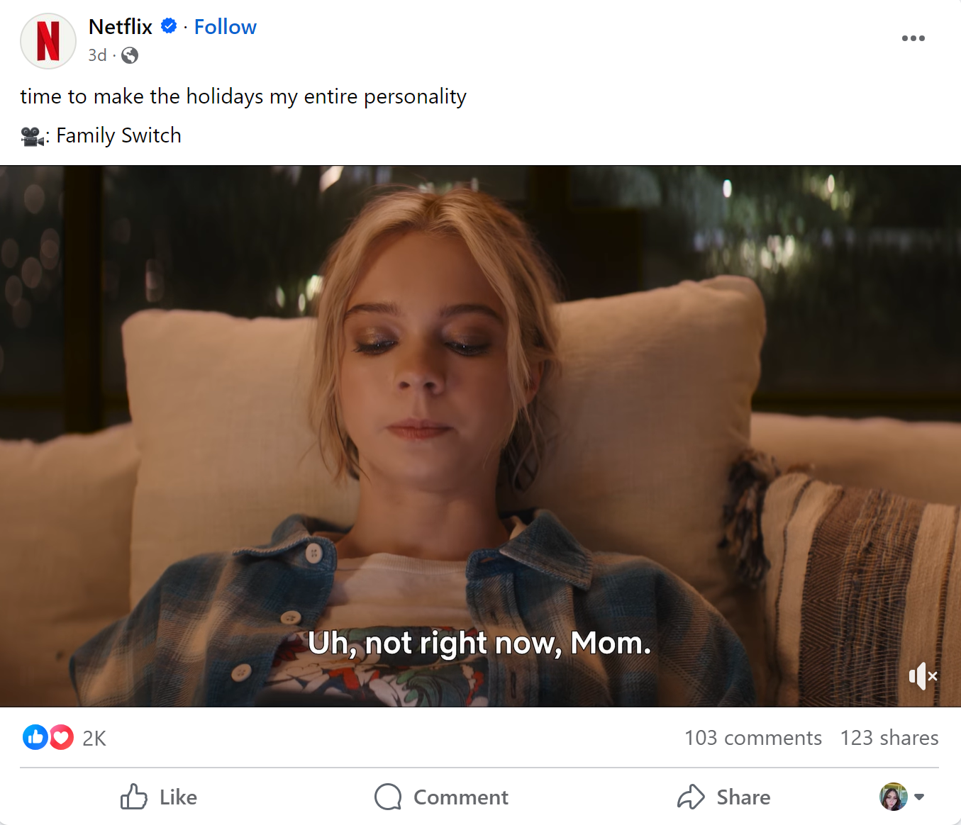
Hypothesis 1: Advertising can help drive Awareness and Engagement
Based off of these Ads from Facebook over the current Netflix productions that have/will be released. We can see how posting on social media drives awareness and engagement to the content netflix is creating. Especially on the Yu Yu Hakusho since it a widely popular Manga that is well known, building up the excitement for the release date brings the audience a sense of excitement and readiness to see the movie soon. Also according to the pie chart, advertising is how we get our most reach to the consumers at hand.

Slide 9
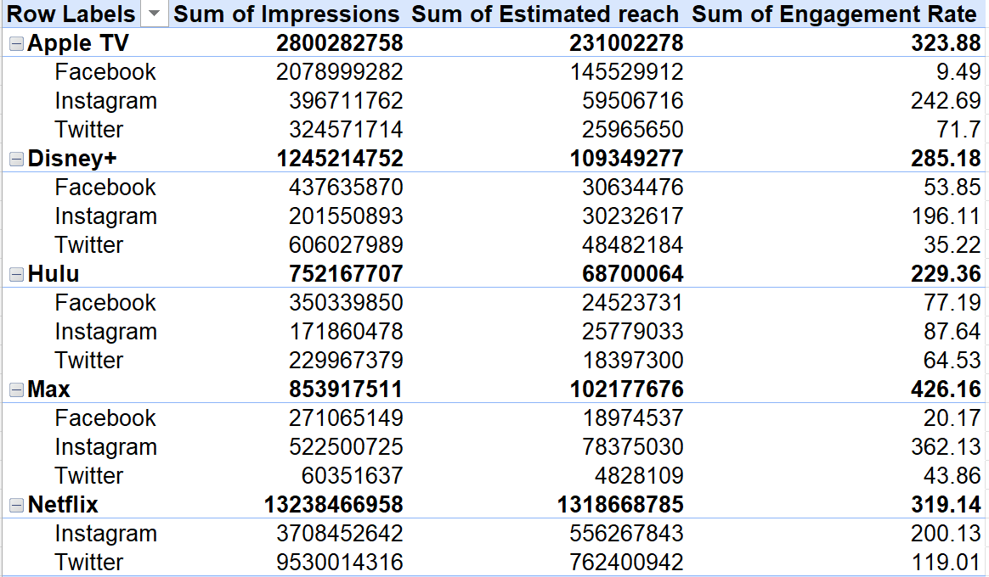
Hypothesis 3: Social Media can be an advertising approach for Netflix
We can see that Apple TV is blowing if out of the park in regards to advertising their content and services on social media. Based on the data we can see that we have some potential moving forward when posting on social media, but we should implement a stronger social media strategy in order to increase our overall impressions, reach, and engagement.

Slide 10
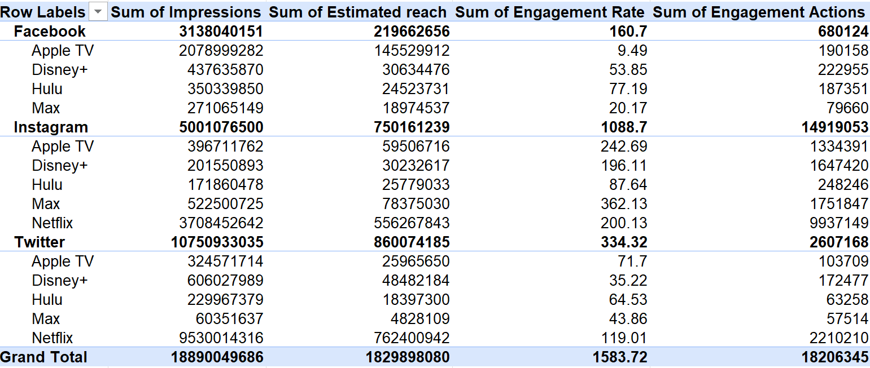
Similar to the table before, we can see how well Apple Tv is doing, however we can see now how many engagement actions we are receiving in comparison to our competitors, therefore showing us how effective social media can really be in regards to click through rates (CTR).

Slide 11
Defend From Reputation Threats
Netflix needs to defend itself from reputation threats in order to protect their overall brand image and subscriber loyalty. As a prominent streaming service with a vast global audience, any negative publicity or controversies related to content, business practices, or security could have negative effects on consumer confidence. Protecting Netflix’s reputation is crucial for maintaining and receiving consumer loyalty, attracting new audiences/consumers, and ensuring a positive perception as a brand in an already competitive market. By addressing and mitigating reputation threats as efficiently as possible, Netflix will be able to uphold their brand integrity, sustain subscriber engagement, and continue to be a trusted and preferred streaming platform.

Slide 12
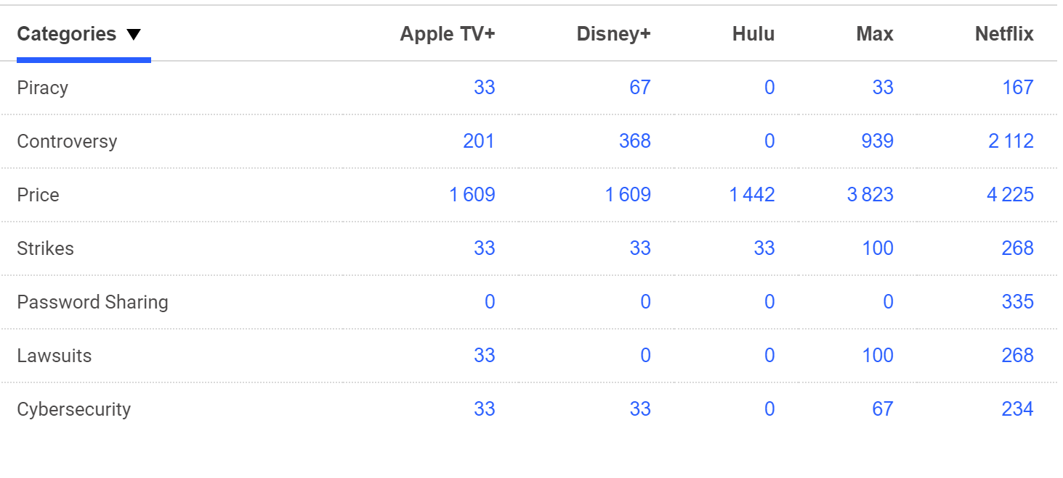
Hypothesis 1: Netflix’s Vulnerabilities, as an industry leader, outweighs the amount of vulnerabilities than their counterparts
We need to acknowledge the fact that we have an overwhelming concerns with our consumers in regards to price, strikes, and cybersecurity. As a leading leader in the industry, the price and cybersecurity aspects of these high volumes make sense. However, the concern for password sharing in comparison to Netflix’s competitors is a bit worrisome and we will investigate this further.

Slide 13
Hypothesis 2: Brand Vulnerabilities can intertwine with current industry leaders (CEOs)
We will follow the next slide in order to see the sentiment behind Netflix’s current leaders and how they can impact the company's brand image as a whole. To summarize the findings, we found that although not a huge threat to the company, what the leaders in the company say/do can partly negatively impact brand image and subscriber engagement as whole.

Slide 14
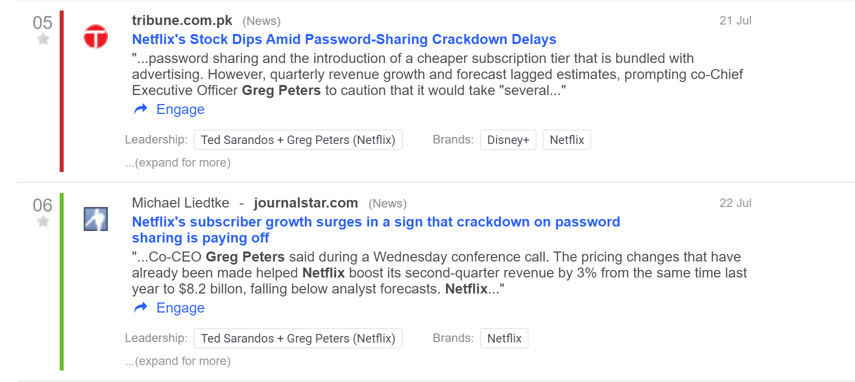
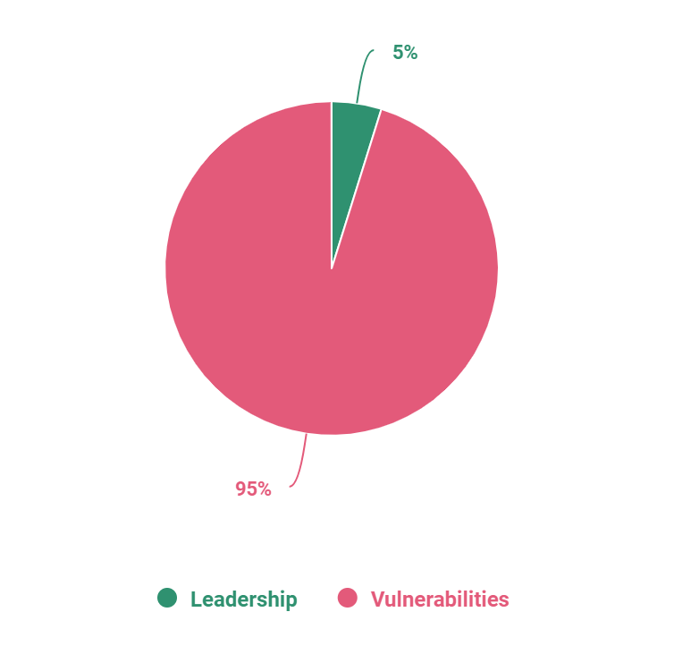
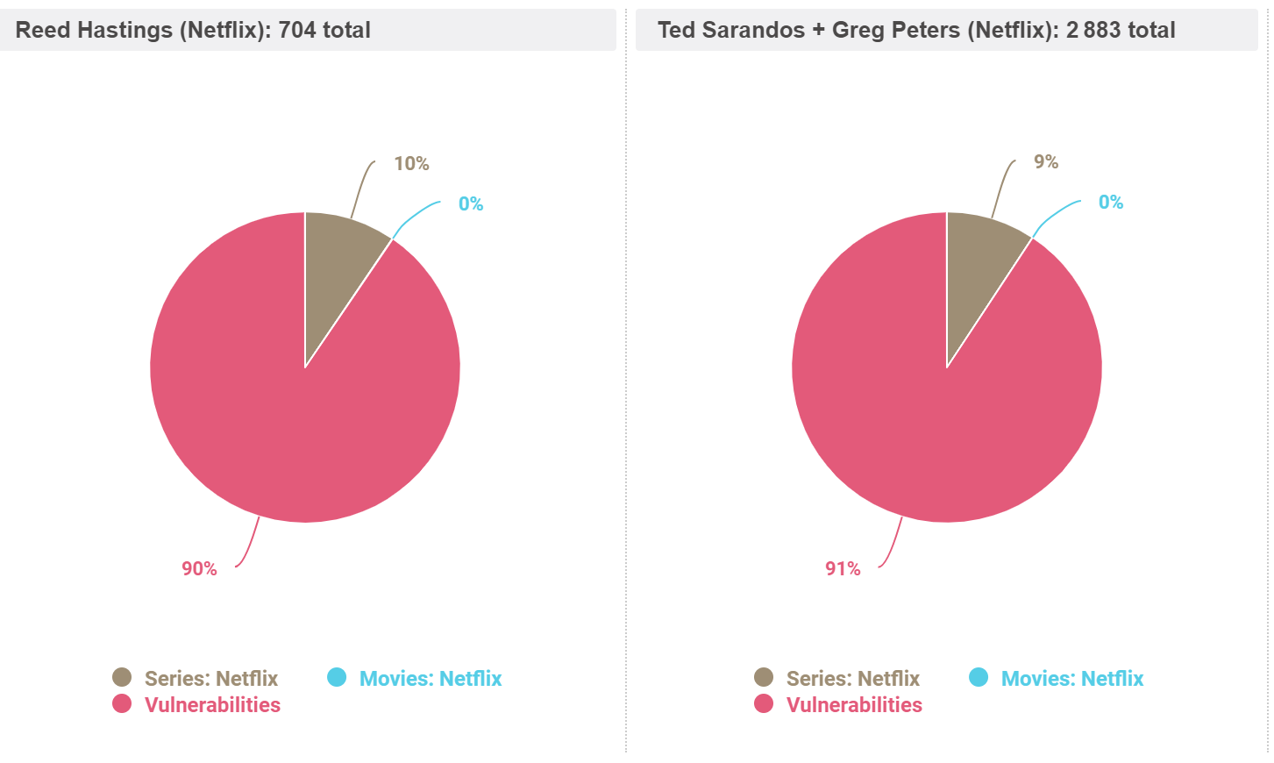
The red and green within this picture indicates negative and positive sentiment in regards to current Netflix leaders and password sharing. We can clearly see that although password sharing is working out in Netflix’s favor currently, we need think about how this could affect the company long term since a lot of consumers loyalty down the line.
These pie charts shows that although a small percentage, shows that leadership does show a difference in overall brand and leadership image. In fact the mention volume for Netflix’s current leaders shows that their mention volume is higher in regards to Netflix’s vulnerabilities than the content itself. Most of these vulnerabilities are due to password-sharing.

Slide 15
Conclusion
In conclusion, the data presented here today shows us the need improvements that Netflix needs to take on, and with our help we will not only to meet our overall goal but exceed them. With this new strategy, examining how to drive new and existing subscriber engagement, better promote content relative to competitors, and defending against reputation threats, we will be able to use every aspect we analyzed it put forth a media strategy that will leaving the streaming industry shaking in their boots.

