Slide 1
Burt’s Bees
By: Sarah Nahas
Leticia Torres
Catherine Hittson
Jaime Garcia
Zoey Martinez

Slide 2
Secondary Research
.

Slide 3
Product Category Research
How much revenue does the product category (or industry) generate?
Burt’s Bees creates 6.7 Billion in revenue each year.
The industry itself reaches 100.13+ Billion.
Impacting performance for the beauty industry:
Keeping up with upcoming trends
Anti-aging skincare is projected to increase substantially between 2020-2026.
Authenticity of what they are claiming to sell (cruelty free, all natural products, etc.)
Is it claiming to be all natural when it isn't?
Greenwashing*

Slide 4
Who, Why, and Competitors
Who typically consumes this product and who are they targeting?
Gen Z, Millennials, and Boomers. Specifically women who have a preference for vegan/cruelty free products in adolescence through mid 40’s.
Why do people consume this product?
All products can be used in a consumer's self care regimen, and Burt’s Bees has a duality to it due to the fact that they have both skincare and makeup products.
Affordable in comparison to competitors. (“Our* demographic plans to purchase affordable but quality products, leading to them spending an average of only $94.03/year”)
Who are the competitors?
L’Oreal, CeraVe, EOS, Neutrogena, Lush, Pixie. (L’Oreal leads in market share)

Slide 5
Burt’s Bees Current Performance
Current Performance
How do they currently market their product?
Web sales: 25-50 million
Order volume: 10,000-50,000
Generated 19.3% of lip balm treatment sales in the US.
350 employees, revenue per employee ratio is $714,285.
Annual Revenue: 6.7 Billion
In 2011 Clorox company bought Burt’s bees.
Started to add more importance into lip, balm, and makeup revenue.
-TCC net worth: 15.99 Billion
Annual Revenue: 7% increase in revenue for 2022.
They use youtube/tv ads!
https://www.youtube.com/watch?v=fouJpunli74
https://www.youtube.com/watch?v=gClvQ42xRTg
Constant social media interaction.
Slogan
“True to Nature”
Celebrity Endorsers
There have not been celebrity endorsers in years, however celebs like Lily Collins and Blake Lively (Emma Chamberlain as well) have stated in interviews that they swear by Burt’s Bees (free celebrity promo).

Slide 6
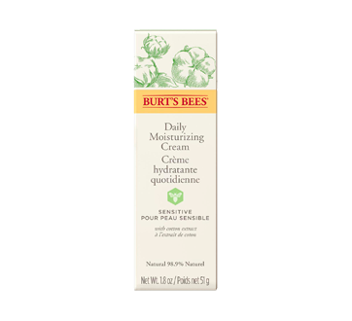
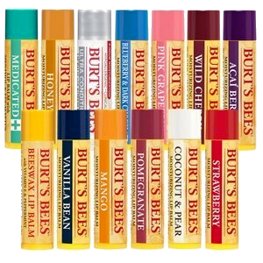
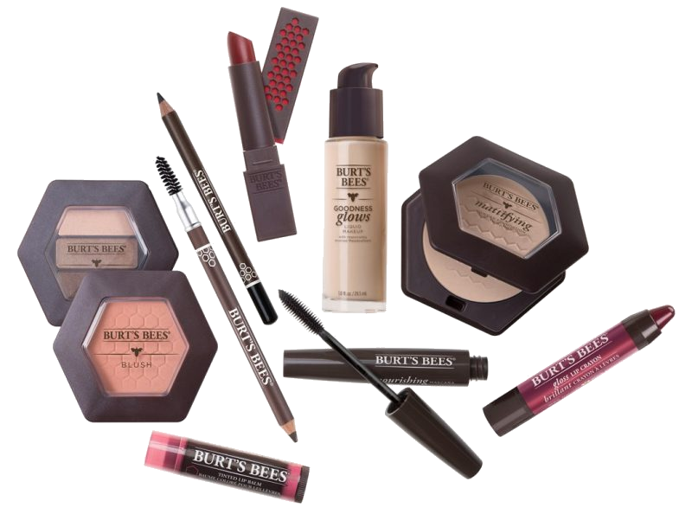
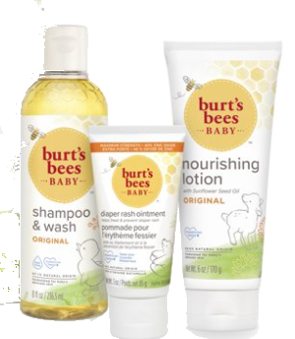
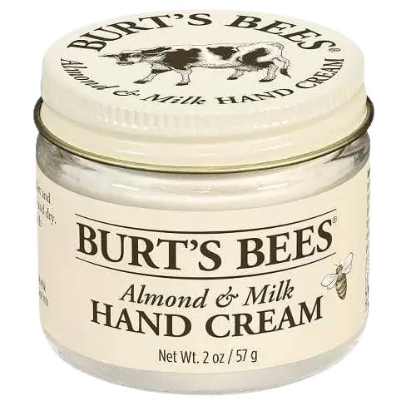
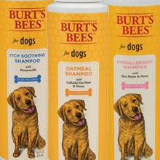
Currently Sold Products
Lip Balm
Skin Care
Makeup
Baby Products*
Body and Hair
Pet Merchandise

Slide 7
Primary Research Findings
Consumer usage situations:
How: Personal use
When: Morning, night, throughout the day
Where: In bathroom, car, public
Why: Anti aging, moisturizing, lip care
Consumer MAO:
M: Looking for a sustainable and affordable brand
A: Readily available to consumers via drugstores and online
O: Affordable prices
c. Consumer exposure: Store shelves / displays.
Attention: Looking at the display of chapstick flavors.
Perception: trying the testers at ULTA.
Comprehension: Seeing the claims of natural ingredients.

Slide 8
Primary Research Findings Continued…
d. Consumer attitudes formed through the peripheral-route processing.
e. Consumer problem recognition and information search:
Attributes: natural products, low prices
Company values: “What you put on your body should be made from the best nature has to offer.”
f. Consumer decision-making processes are low effort decision making process.

Slide 9
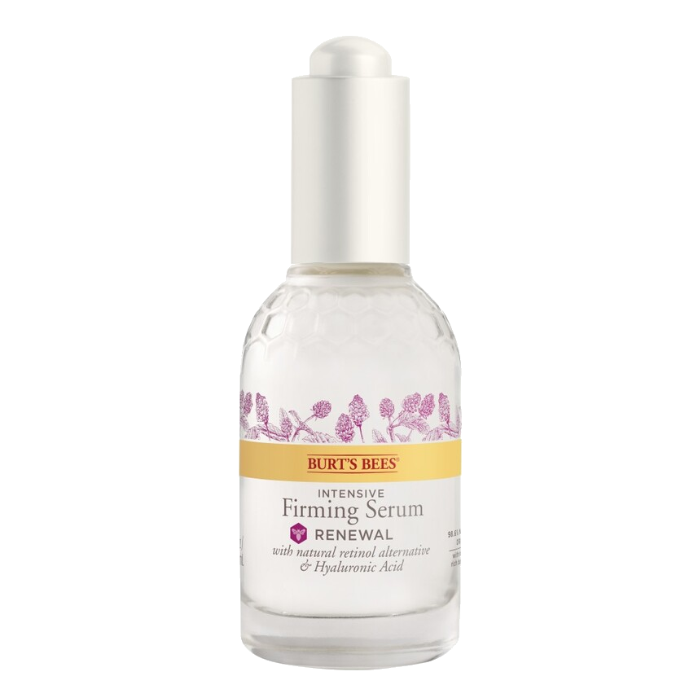
PRODUCT RECOMMENDATION:
This skin firming serum is 98% natural and contains bakuchiol, also known as a retinol alternative, can help soften fine lines and wrinkles, improve skin tones! Our changes for this product would include adding a pump because our consumers will be able to use this serum easily instead of removing the top & causing mess. Next, we would change the thick substance to a more clear & thin form so it is not heavy on the skin.
Renewal Intensive Firming Serum $19.99
‹#›

Slide 10
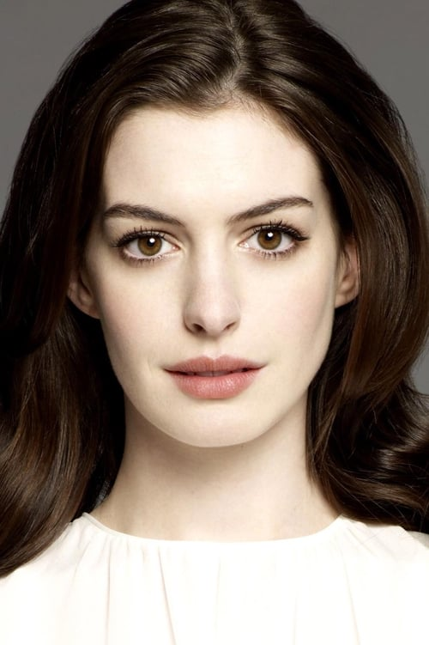
BRAND RECOMMENDATION:
Anne Hathaway, an American actress, known for her role in ‘The Devil Wears Prada’ and ‘The Princess Diaries’. Hathaway addresses how important it is to apply a moisturizer twice a day and believes our skin is the most beautiful when it is properly nourished. She encourages beauty lovers to express themselves in whatever makes them happy and confident, this is why she would make the perfect fit for Burt’s Bees.

Slide 11
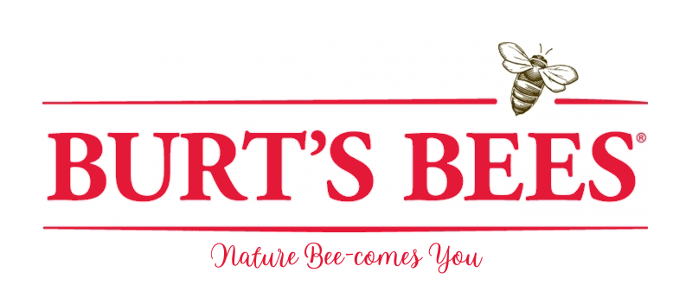
BRAND RECOMMENDATION:
Changing the brand slogan by using their old slogan, “Nature Becomes You” and making it, “Nature BEE-comes You”. By doing this, we are creating a slogan that is more memorable to the customers.

Slide 12
SWOT ANALYSIS
STRENGTHS
Affordable and Easily Accessible
Sustainable and Cruelty Free
Effectively expanding into other new products
WEAKNESSES
Burt’s bees is heavily marketed towards The US and can branch out.
Needs to market their other products because they are not as well known (kids line, mens line)
S
W
- Design products to look more gender neutral.
-Applicator and dispenser could be included within the shampoo and conditioner bottles.
OPPORTUNITIES
Lots of competitors using similar marketing and brand strategies
A lesser known brand in comparison to major drugstore brands.
THREATS
O
T

Slide 13
2. EXTRA RESOURCES
For Business Plans, Marketing Plans, Project Proposals, Lessons, etc

Slide 14
Marketing Strategy
Social Media
Create unique and engaging content
Post more frequently
Cross-Promote Channels
Content
Videos/tutorials on how to use their products
More organic content
Collaborations with…
Influencers
Spas/Venues
Non-Profit Organization/ Good Cause

Slide 15
Potential Expansion
Since they are not in as many countries as their competitors, Burt’s Bees could potentially become more successful and well known if they sold in other regions of the world
By conducting market research on different regions, Burt’s Bees can effectively create a strategic marketing plan, and can even produce products that are catered to those specific consumers

Slide 16
Sources
Burt’s Bees | Home Page. (n.d.). Burt’s Bees. https://www.burtsbees.com
Brand Story Hero – Burt’s Bees. (2018, November 29). All Good Tales. https://allgoodtales.com/brand-story-hero-burts-bees/Statista. (2022, February 21). Cosmetics industry - Statistics & Facts. https://www.statista.com/topics/3137/cosmetics-industry/#topicHeader__wrapper
Burtsbees.com Traffic Analytics & Market Share. Similarweb. (n.d.). Retrieved April 24, 2022, from https://www.similarweb.com/website/burtsbees.com/#social-media
Home Page. Burt's Bees. (n.d.). Retrieved April 24, 2022, from https://www.burtsbees.com/
Kahn, H. (2021, October 28). This bestselling Burt's bees skincare set is the perfect stocking stuffer. Us Weekly. Retrieved April 24, 2022, from https://www.usmagazine.com/shop-with-us/news/score-this-bestselling-skincare-set-from-burts-bees-before-it-sells-out/
U.S. skin care market. Statista. Retrieved April 24, 2022, from https://www.statista.com/topics/4517/us-skin-care-market/#dossierKeyfigures https://www.burtsbees.com/ https://www.usmagazine.com/shop-with-us/news/score-this-bestselling-skincare-set-from-burts-bees-before-it-sells-out/ https://www.similarweb.com/website/burtsbees.com/#social-media
Statistica Research Development. (2022, February 16). Topic: U.S. skin care market. Statista. Retrieved April 2, 2022, from https://www.statista.com/topics/4517/us-skin-care-market/#topicHeader__wrapper

